Slide 1

UEEN 3113 / 3413
Server Configuration and management

Slide 2
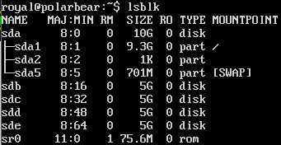
RAID Management
RAID can be configure during the installation of OS
The package mdadm can be used to manage / configure RAID at a later time after the OS installation
To install:
sudo apt install mdadm
It’s better to check on the disks available in the system
lsblk

Slide 3

RAID Management
We might want to check for any existing RAID blocks on the disks before configuration.
sudo mdadm -E /dev/sdX
Example: sudo mdadm -E /dev/sd[b-e]

Slide 4
RAID Management
To create RAID device
sudo mdadm -C /dev/mdX -l RAID_level -n num_of_disks /dev/sdX
-C : create, -l : RAID_level, -n : number of disks to be used
Example: sudo mdadm -C /dev/md0 -l 5 -n 3 /dev/sd[b-d]

Slide 5
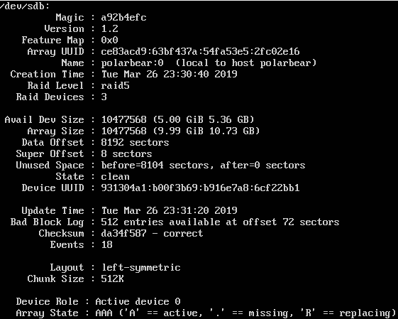
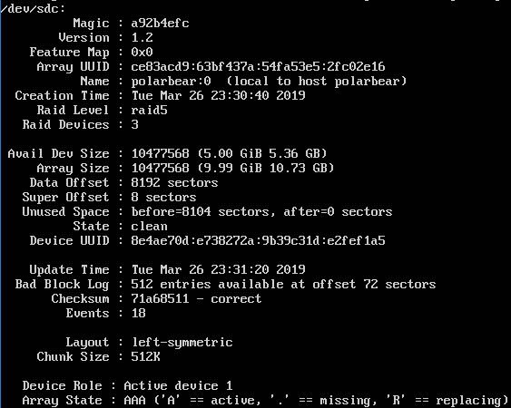
RAID Management
Checking for existing RAID blocks on disks after the creation will display information for each disk in RAID

Slide 6
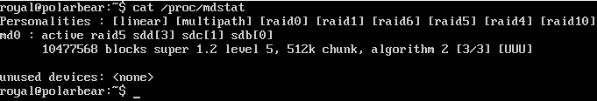
RAID Management
Another way to check the RAID is looking at the mdstat output
cat /proc/mdstat
The creation process might take longer time, we can monitor the process using the watch command
watch -n 1 cat /proc/mdstat

Slide 7
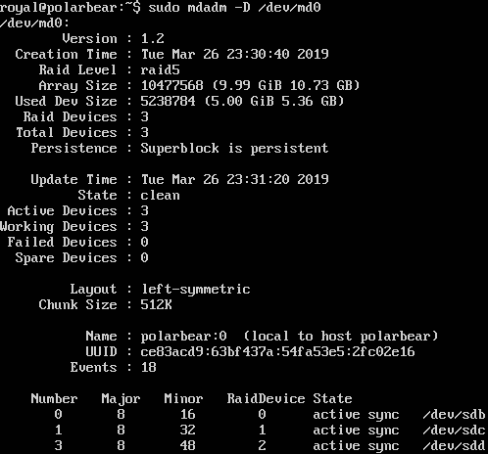
RAID Management
We might want to verify the RAID devices are running
sudo mdadm -D /dev/mdX
Example: sudo mdadm -D /dev/md0

Slide 8
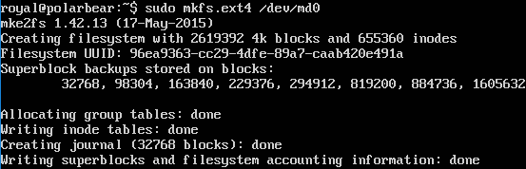
RAID Management
Disks are added into RAID array and are active. However, filesystem has not been created
To create ext4 filesystem: sudo mkfs.ext4 /dev/md0

Slide 9

RAID Management
Create a mount point to mount the RAID device
Example, sudo mkdir /mnt/rd5
Mount the RAID to mount point
Example, sudo mount /dev/md0 /mnt/rd5
There should be a “lost+found” directory in the mount point

Slide 10


RAID Management
To check the disk free space, use the df command
Example: df -h /dev/md0
Since we want to use the RAID, we need to configure /etc/fstab so that it will be mounted automatically when the system starts

Slide 11

RAID Management
Store the current configuration to the mdadm configuration file (/etc/mdadm/mdadm.conf)
sudo mdadm -D -s | sudo tee -a /etc/mdadm/mdadm.conf
The configuration should be appended to end of the file

Slide 12
RAID Management
Next, update the initramfs file so that RAID array will be available when the machine boot.
sudo update-initramfs –u

Slide 13
RAID Management
If there is an additional disk, it can added into RAID as a spare disk.
If any of the disks fails, the spare disk will get active and the process to rebuild and sync data can start
To add (e.g. /dev/sde) into the RAID:
sudo mdadm --add /dev/md0 /dev/sde

Slide 14
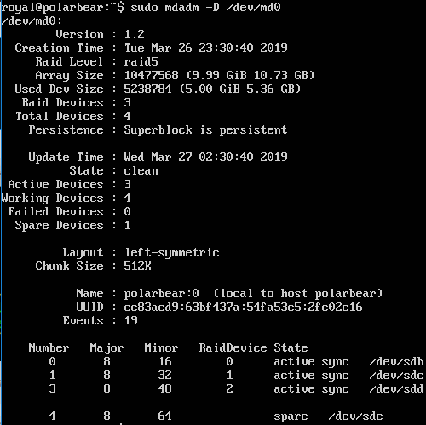
RAID Management
Check the RAID device
sudo mdadm –D /dev/md0

Slide 15

RAID Management
We can a disk as failed by using mdadm manage mode
E.g. mark /dev/sdc failed:
sudo mdadm --manage --fail /dev/md0 /dev/sde
With a spare disk available, the rebuild process should be started.

Slide 16
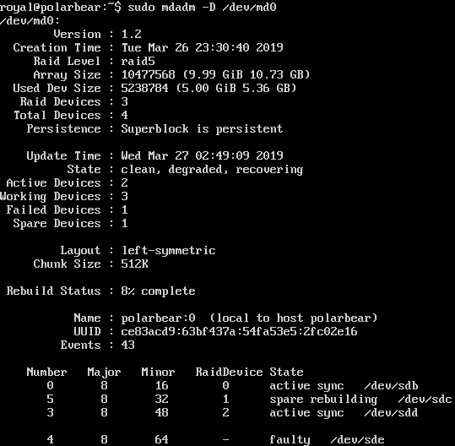
RAID Management
To verify rebuild process, e.g.: sudo mdadm -D /dev/md0

Slide 17
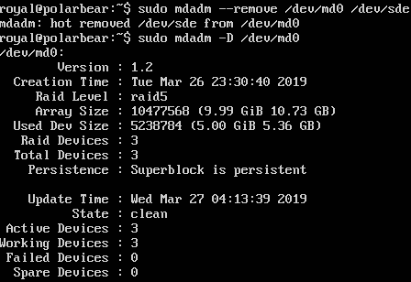
RAID Management
To remove a failed disk from RAID
E.g.: sudo mdadm --remove /dev/md0 /dev/sde

Slide 18
RAID Management
To increase the number of RAID devices:
sudo mdadm --grow --raid-devices=N /dev/mdX
For RAID 5 and 6, we need to include an option to back up critical information during growing process
sudo mdadm --grow --raid-devices=N --backup-file=/path/to/backup_file /dev/mdX

Slide 19

RAID Management
In case we want to stop using RAID array, we have to unmount the RAID device before we stop it.
To unmount, e.g.: sudo umount /mnt/rd5
To stop the RAID array:
E.g.: sudo mdadm --stop /dev/md0

Slide 20
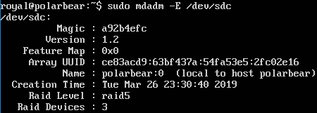
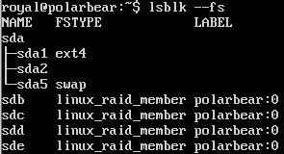
RAID Management
Although the RAID array is stopped, but the superblock still exist in each disk. The following shows the output of examining the disks.

Slide 21
RAID Management
Another command option to get disk information:
E.g. sudo mdadm -Q /dev/sdc

Slide 22
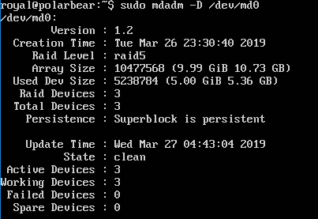
RAID Management
To start the stopped RAID array, we have use the assemble option.
E.g.: sudo mdadm --assemble /dev/md0

Slide 23
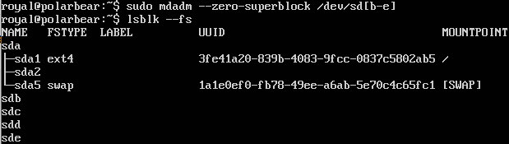
RAID Management
To remove the RAID array
E.g.: sudo mdadm --remove /dev/md0
To remove the superblock from disk:
E.g.: sudo mdadm --zero-superblock /dev/sd[b-e]
Verify the action with lsblk --fs

Slide 24

RAID Management
Remove/comment out the entry in /etc/fstab
Remove/comment out the configuration in /etc/mdadm/mdadm.conf
Update the initramfs file
sudo update-initramfs -u

Slide 25


